Slide 1
Deep dive into safe SharePoint Server/Online branding using repeatable patterns and practices
Vesa Juvonen, Microsoft
Jeremy Thake, Microsoft

Slide 2

Jeremy “Sad eyes” Thake
Microsoft
Jeremy.thake@microsoft.com
If you have any questions on app model or for Office 365 APIs, do not hesitate to send me an email.

Slide 3

Vesa Juvonen, MCM/MCSM
Senior Program Manager, Microsoft
twitter.com/@vesajuvonen
vesa.juvonen@microsoft.com
App model questions to http://aka.ms/OfficeDevPnPYammer please
Office 365 Dev Patterns and Practices program lead, SharePoint MCM/MCSM instructor, JDP program technical lead, hands on in transition projects for customers and in engineering

Slide 4
Agenda
Introduction
Themes and other branding techniques
Branding management
Responsiveness

Slide 5
“You do not brand Outlook or Word, why do you need to do branding on collaboration sites?”
Good question…
Applying branding is absolutely supported and understandable for intranet portals, but what about collaboration sites? It is recommended to consider the cost versus gain.

Slide 6
Introduction

Slide 7
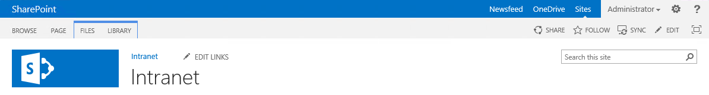
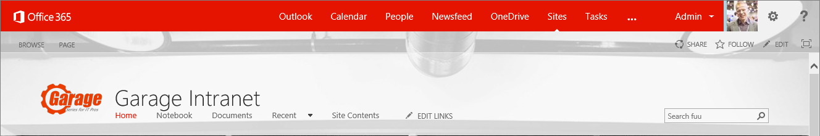
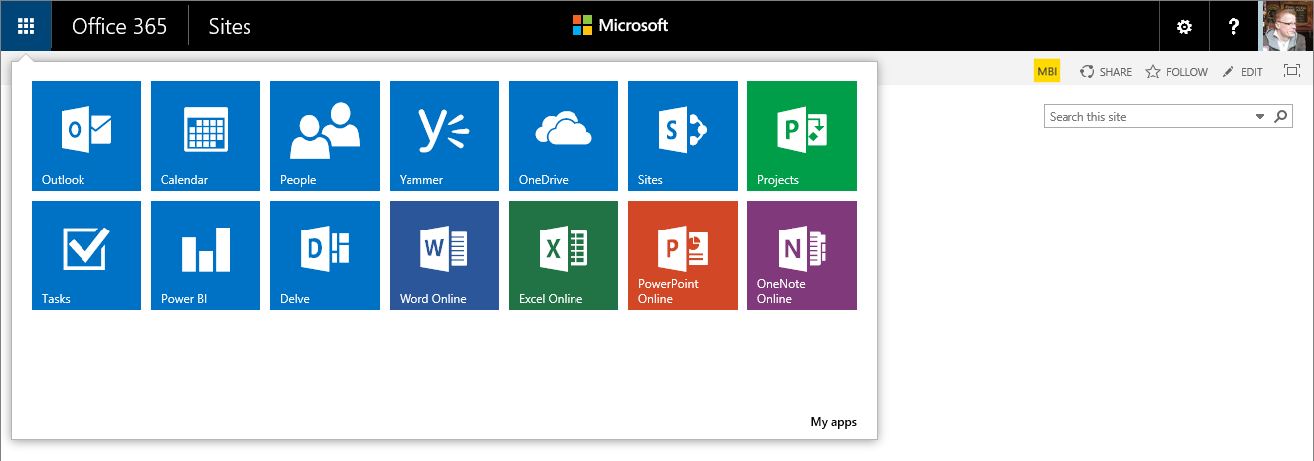
Evolution of the end user experience
Notes:
Vesa Great Slide to explain the methodology and thinking behind why we want to discourage these EXC

Slide 8
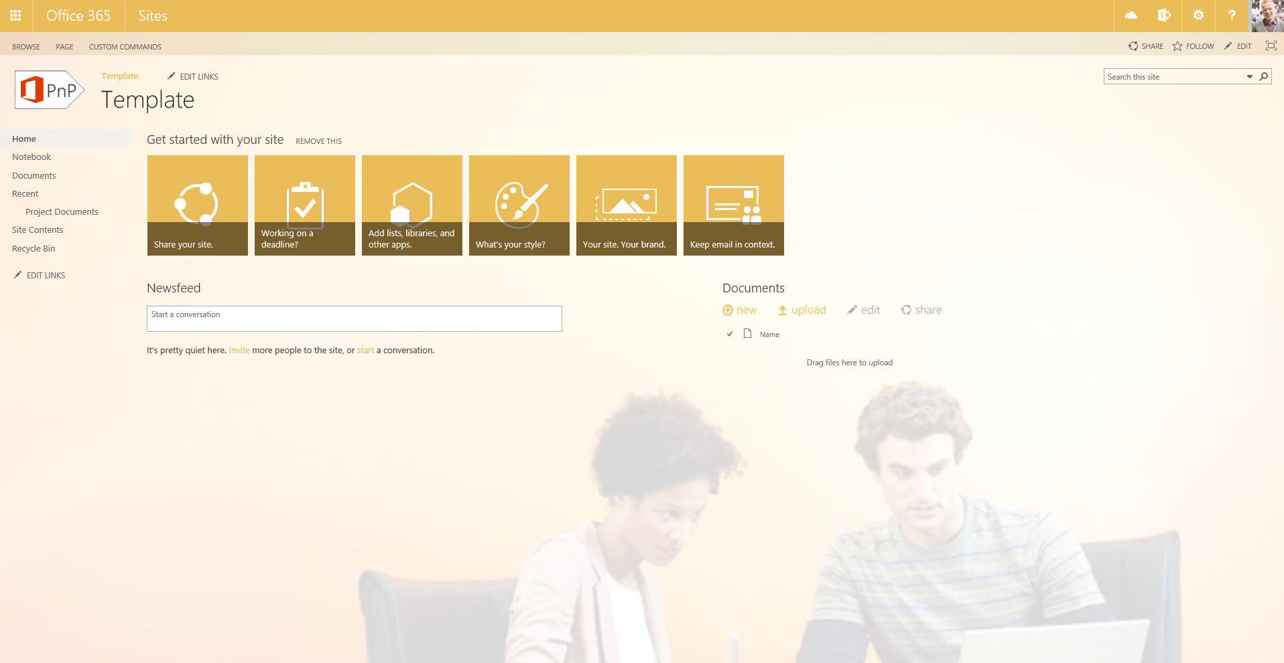
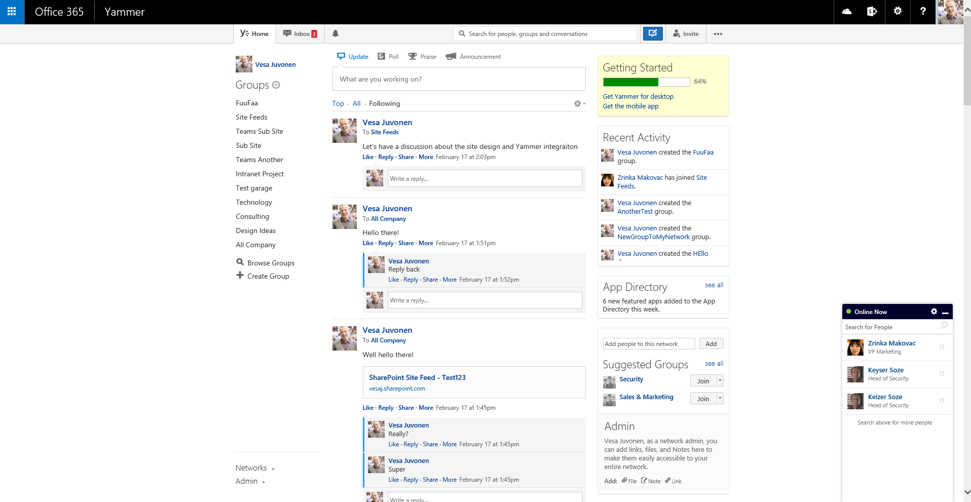
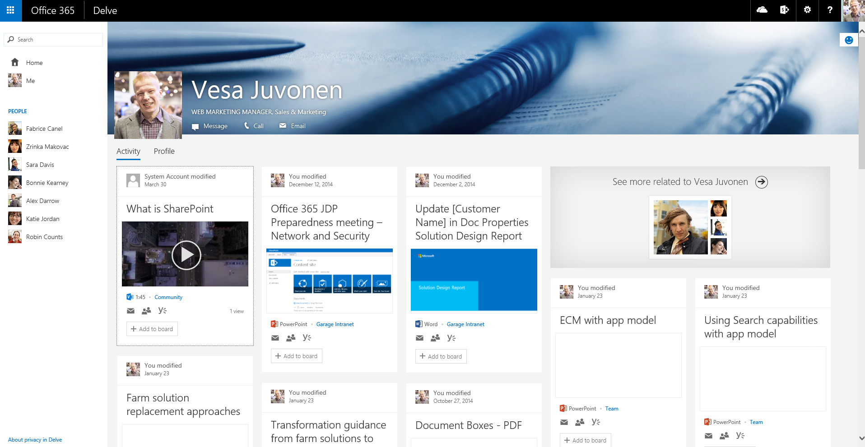
Office 365 services and branding

Slide 9

How to minimize future maintenance?
Use themes rather than custom master pages
All changes to OOB master pages are provided to your sites automatically without need to modify custom code
Avoid feature framework element usage
Many feature framework elements will create dependency to xml files on the disk , which then cannot be removed easily (think “Content Migration”)
Sandbox solutions will also impact future cost model of the Office365 sites
Notes:
Vesa

Slide 10
What is the challenge with custom master page?
New custom master page is created by copying oob master or starting from scratch using oob master as the reference
Significant differences on the outcome unless custom master page been updated during the releases.
contoso.master
contoso.master
contoso.master
master
Version 1.0
master
Version 1.0
master
Version 1.0
<< Copy >>
Custom Master
Oob Master
Seattle.master
Seattle.master
Seattle.master
master
Version 1.0
master
Version 2.0
master
Version 3.0
Time
Service updates for introducing new version of the out of the box master page with some new capabilities or bug fixes.
Notes:
Vesa
Risk is that for sites created from the time WE updated the service until the time YOU updated your Templates, these sites will NOT have all of the features

Slide 11
“But I have always customized my sites with custom master, what has changed?”
Nothing
This similar maintenance challenge exists in on-premises and across the version upgrades as well. We just want to ensure that these implications are known and there’s no future surprises on how the product works.
Notes:
Vesa

Slide 12
“How should I get my files uploaded to the SharePoint sites? Using sandbox?”
No.
It is recommended to upload files as part of the site provisioning process remotely using so called “remote provisioning” pattern directly using remote APIs.
Notes:
Vesa

Slide 13
“I have an intranet portal and I need to do heavy branding customizations!”
Absolutely fine.
Key point is to understand the impact of the chosen pattern. Custom master pages are completely supported, you might want to use alternative approaches if possible.
Notes:
Vesa

Slide 14
Themes

Slide 15

Themes
What
Provide user branding elements without introducing master page or page layout elements
Why
Continue using out of the box master pages, but introduce customer specific branding elements
How
Use theming engine for introducing color, fonts and background images for sites
Notes:
Steve

Slide 16
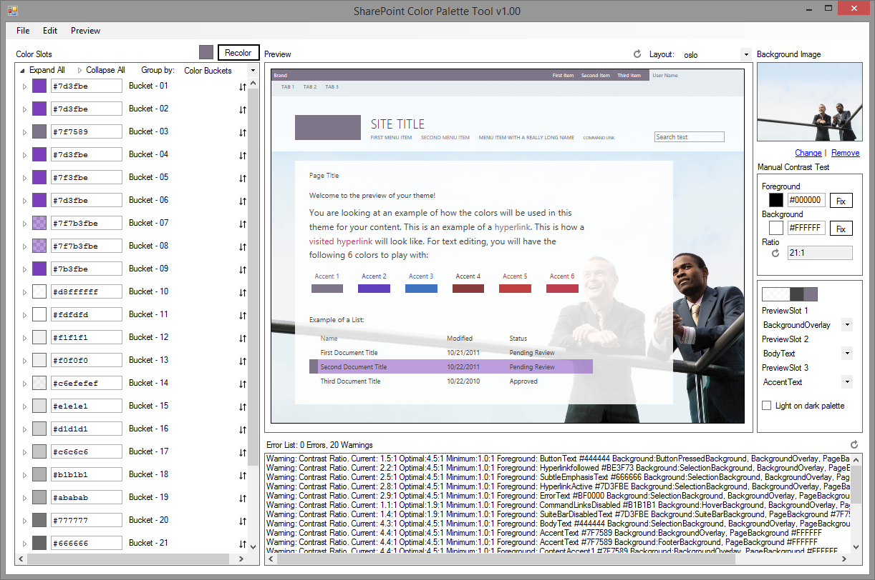
SharePoint Color Palette Tool v1.00
Free downloadable tool to create custom themes based on branding requirements from Microsoft download site
Can be used to create themes in matter of minutes with company colors and images
Notes:
http://www.microsoft.com/en-us/download/confirmation.aspx?id=38182
Steve

Slide 17
Use themes rather than custom master pages
Themes are more future friendly than custom master pages…
Why?
Notes:
Steve

Slide 18
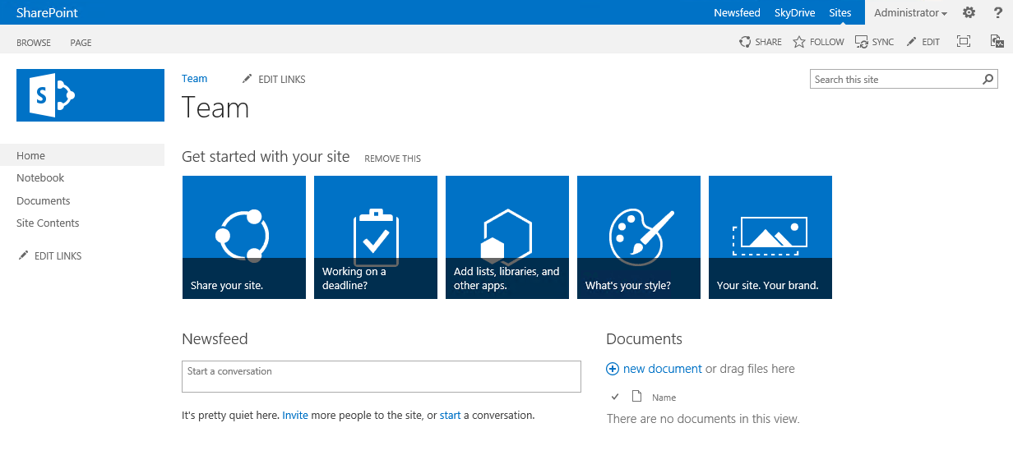
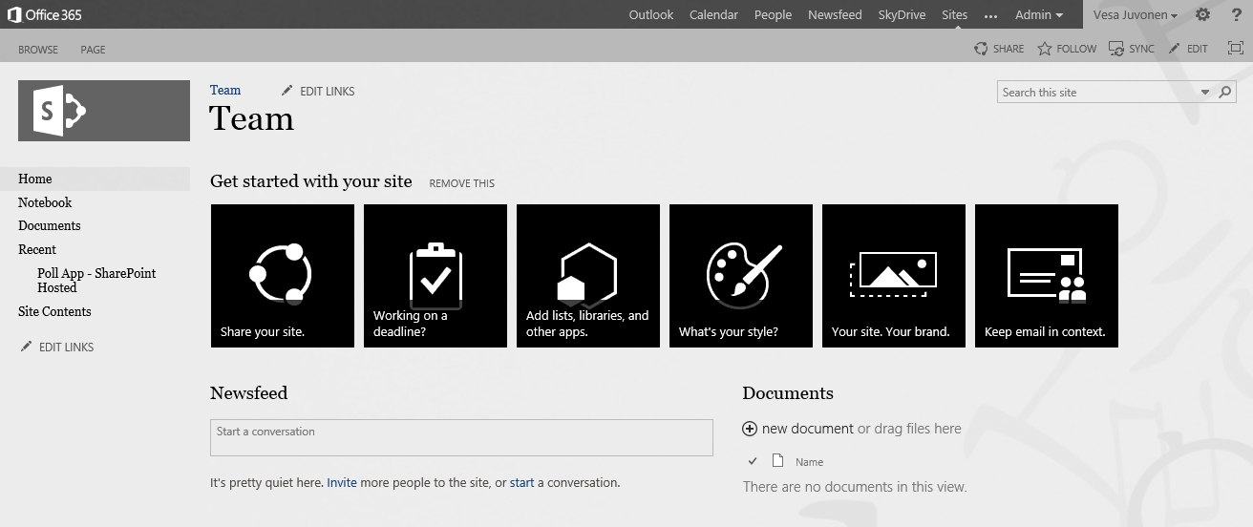
Handling themes from SP Apps
1
Provider Hosted Apps
SharePoint Service
CSOM
3
Upload needed files
Set theme to site
(Set master page to site)
Theme elements
2
Color file
Font file
Background image
(Master page)
Notes:
Steve App is started from the web by end user or process is started during provisioning
App side has the needed theme elements and other assets for sites, which will be published
App drives the modification of the host web by applying the needed customizations to host web

Slide 19
Using themes for branding
Controlling site branding by using themes
https://github.com/OfficeDev/PnP/tree/master/Scenarios/Branding.Themes

Slide 20
Office 365 Themes

Slide 21
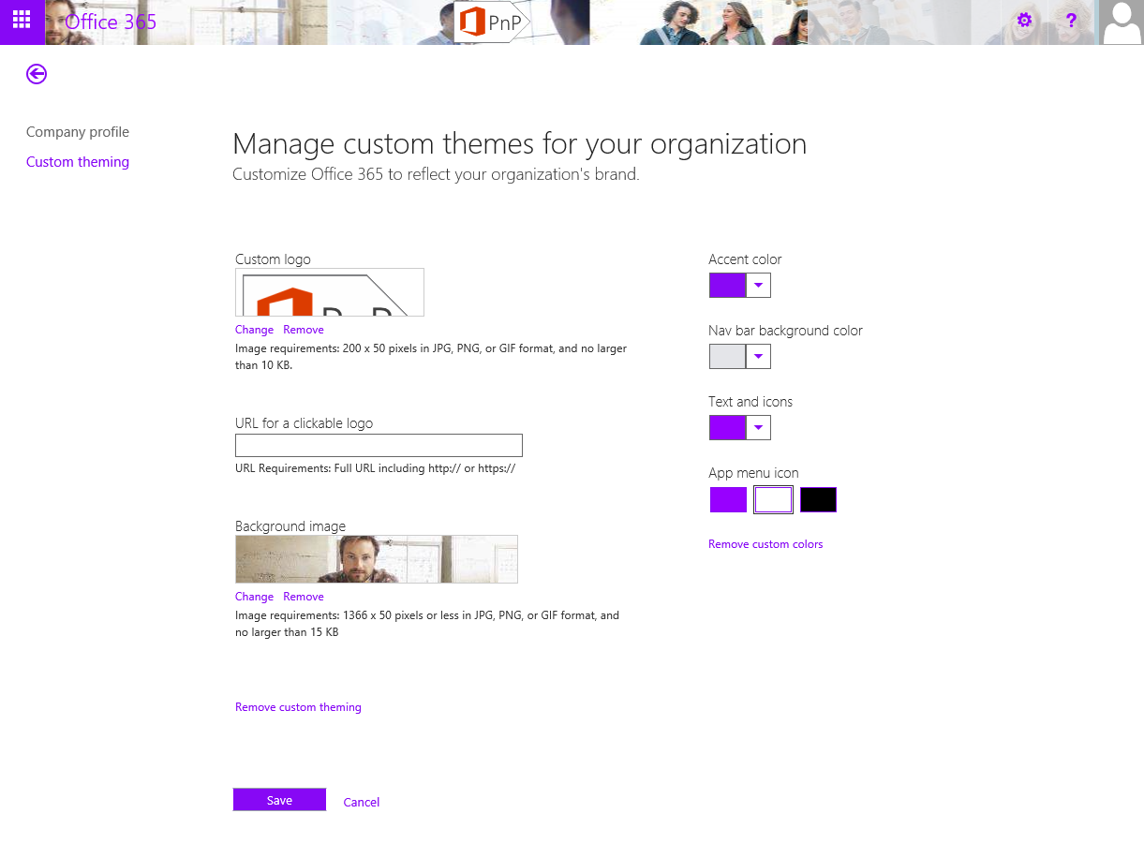
Controlling themes for Office 365
Notes:
vesa

Slide 22
Office 365 Themes
Where are they and how to use?

Slide 23
Alternate CSS

Slide 24
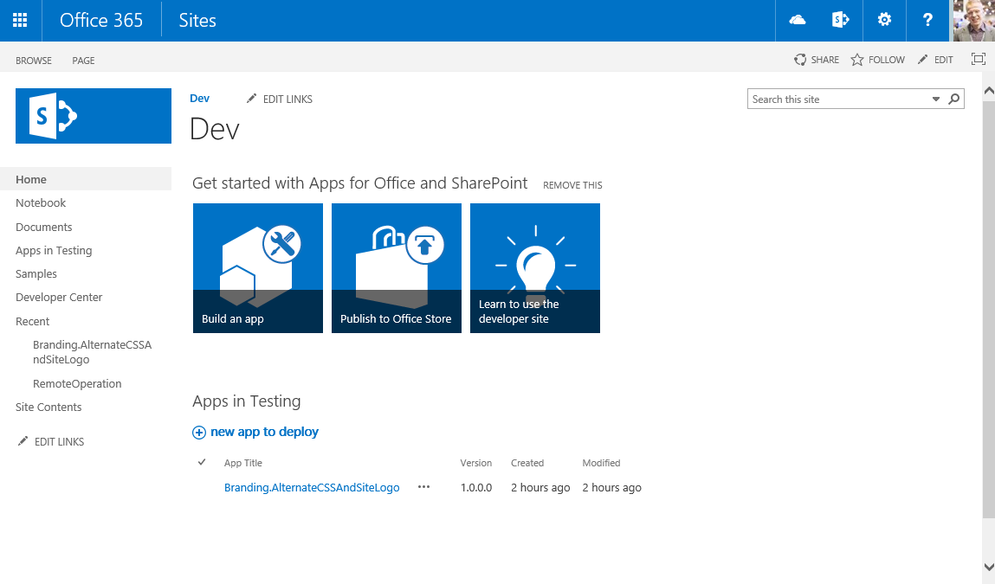
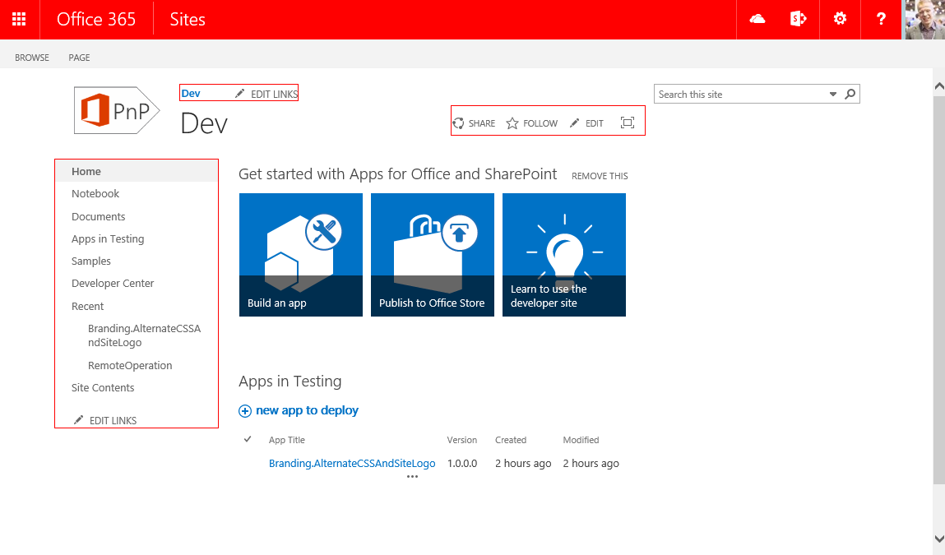
Controlling CSS from App
1
Provider Hosted Apps
SharePoint Service
CSOM/REST
3
Upload CSS
Set alternate CSS for the site
Assets
2
CSS file
Images
Notes:
Steve App is started from the web by end user or process is started during provisioning
App side has the needed theme elements and other assets for sites, which will be published
App drives the modification of the host web by applying the needed customizations to host web

Slide 25
Using custom css and custom logo
Customizing branding without custom master page
https://github.com/OfficeDev/PnP/tree/master/Samples/Branding.AlternateCSSAndSiteLogo

Slide 26
Branding with publishing sites and responsive experience

Slide 27
Controlling master page and page layouts from app
1
Provider Hosted Apps
SharePoint Service
3
CSOM/REST
Upload master page
Upload page layouts
Set site master page using CSOM
Set page layouts
Set allowed site templates
Branding assets
2

Slide 28
Responsive Seattle master
Looking for responsive experience with out of the box master pages

Slide 29
Summary on branding options

Slide 30


Branding options for SharePoint sites
Office 365 Themes
Theme
Alternate CSS
Custom Master Page
Can be used to centrally control branding cross all services in the Office 365
Limited settings currently
Can be overridden in site level
Only in Office 365, not in on-premises
Can be used to control branding, fonts and background image of the sites
Configuration applied to each site
Can be used to override whatever CSS settings
Control to color, fonts and even layout settings
Configuration applied to each site
Full control on how the site is rendered
Applied to each site, except for publishing sites
Any updates to oob master pages are not automatically reflected on the sites
Options
Support
only
Flexibility
Fair
Average
Good
Unlimited
Cost impact (short and long term)
Notes:
Vesa & Steve Dialog

Slide 31
Branding options
Notes:
Vesa & Steve Dialog

Slide 32
What about custom controls in my custom master page?
JavaScript Embedding provides us capability to provide UI level changes as well without need of custom master pages…

Slide 33
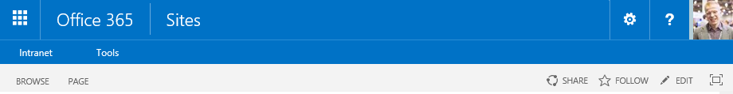
Providing UX with app model
Old model
Custom web control on master page
Full trust solution deployment with its implications
New model
Client-side rendering using JavaScript on the site
Taking usage of the greatly enhanced CSOM and REST APIs in SharePoint
Dynamic update of the capability without maintenance window

Slide 34
JavaScript embedding for web control replacement
Association of JavaScript embedding (user custom action) to the site, so that code is executed during site processing
SharePoint Service
1
Provider Hosted Apps
CSOM / REST
2
<<Reference>>
js
3
UX component or elements are rendered using CSOM with JavaScript stored either in SharePoint or centrally outside fo the SharePoint, for example in provider hosted app site.
Notes:
Vesa

Slide 35
Embed second level navigation
Using app modle techniques to provide UX capabilities in the sites
https://github.com/OfficeDev/PnP/tree/master/Samples/OD4B.NavLinksInjection
Notes:
Vesa

Slide 36
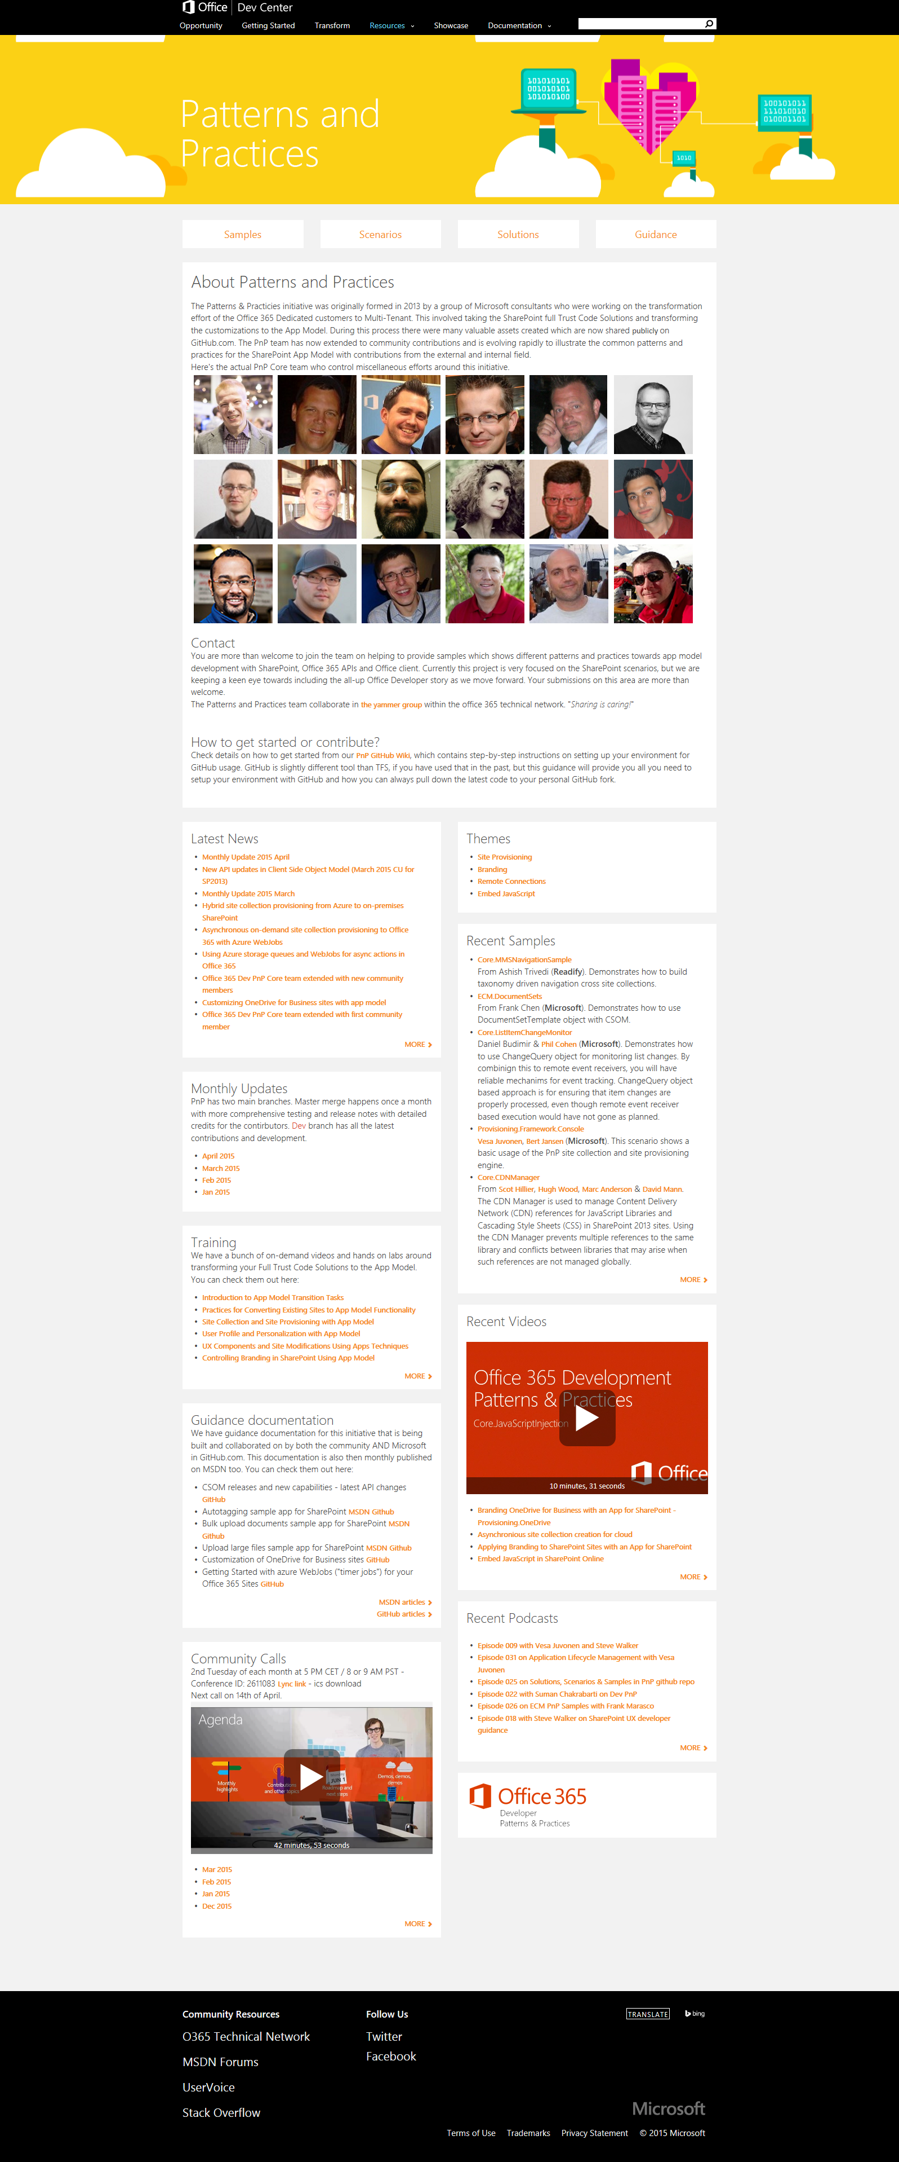

“Sharing is caring”
aka.ms/OfficeDevPnP
aka.ms/OfficeDevPnPYammer
aka.ms/OfficeDevPnPMSDN
aka.ms/OfficeDevPnPVideos
aka.ms/OfficeDevPnPTraining

Slide 37
Summary
Introduction
Themes and other branding techniques
Branding management
Responsiveness

Slide 38
Thank you for attending!
Jeremy Thake
Vesa Juvonen

